Slide 1
SMART BABY CRADLE
Anakha Pavithran
Roll No : 17
S4 MCA

Slide 2
CONTENTS
Relevance of the topic
Description of the topic
Objectives of the study
Existing and Proposed System
Tools Used
Future Deliverables

Slide 3
Relevance of the Topic
Today’s life style is fast paced. Most of the working parents find a bit difficult to manage work along with babysitting. They can’t keep an eye on their child all the time and is hard after long working hours.
To sooth the baby by manually swinging the cradle might not be possible in such case. Hence there is need of product which bridges this gap between parents and baby.
This cradle system is proposed to help these parents, so that they can take good care of their baby.

Slide 4
Description of the Topic
The smart cradle automatically swings according to baby cry. An Arduino microcontroller will be used to assemble all the sensors and hardware component required. Constant monitoring of the baby inside the cradle will be done. If any activity such as urination or baby waking up from sleep occurs a notification through an SMS will be sent to the parent’s device.

Slide 5
OBJECTIVES
Parents can work freely without any tension.
Reduced time consumption.
Better look after of child.

Slide 6
Existing System & Proposed System
Existing System
The present system is like babysitter look after the child. The cradle has to be swung by the babysitter or parents itself.
Proposed System
The smart cradle automatically swings according to baby cry. An Arduino microcontroller will be used to assemble all the sensors and hardware component required. Constant monitoring of the baby inside the cradle will be done. If any activity such as urination or baby waking up from sleep occurs a notification through an SMS will be sent to the parent’s device.

Slide 7
TOOLS
Software used :
Python IDLE(PyCharm)
XAMPP
Arduino IDLE
Hardware used:
Arduino
Motor
Sound Sensor, Moisture Sensor
DHT Sensor
Relay

Slide 8
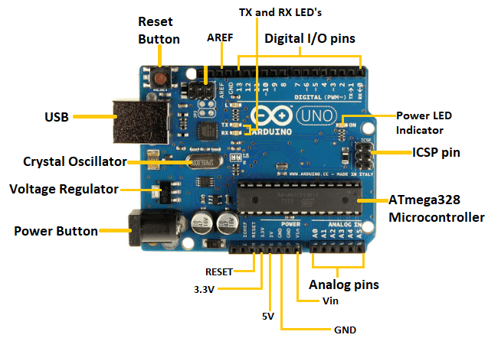
ARDUINO
It is a microcontroller based kit.
It is cheap and good for projects.
It consist 14 digital i/o pins.

Slide 9
SOUND SENSOR
Sound sensor detects sound waves through its intensity and converting it to electrical signals. Here it detects baby sound.

Slide 10
MOISTURE SENSOR
Moisture sensor are used to measure wetness in the cradle.

Slide 11
DHT SENSOR
It is a temperature and humidity sensor.
DHT11 is commonly used sensor.

Slide 12
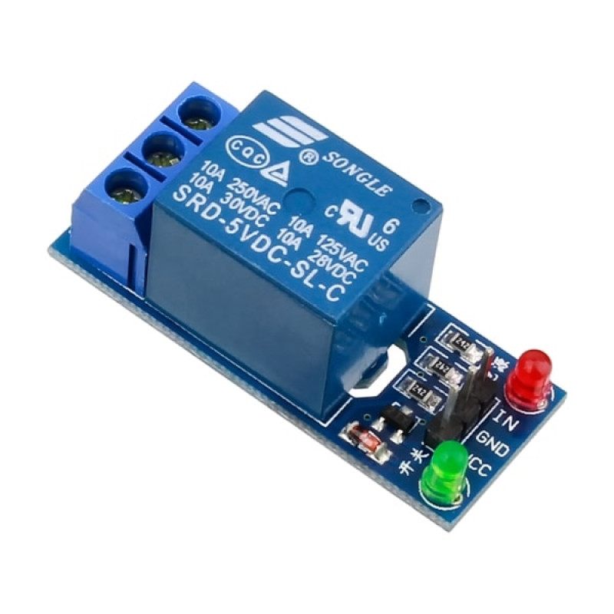
RELAY
Relay are switches which opens and closes circuits electronically.
Letting the current go through or not, and controlled with low voltages ,like 5v provided by Arduino pins.

Slide 13
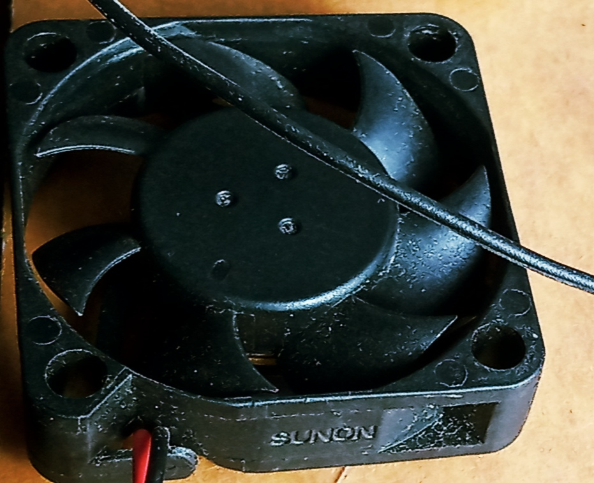
MOTOR
When baby crying it detects by sound sensor and thereby motor will works and cradle automatically swings.

Slide 14
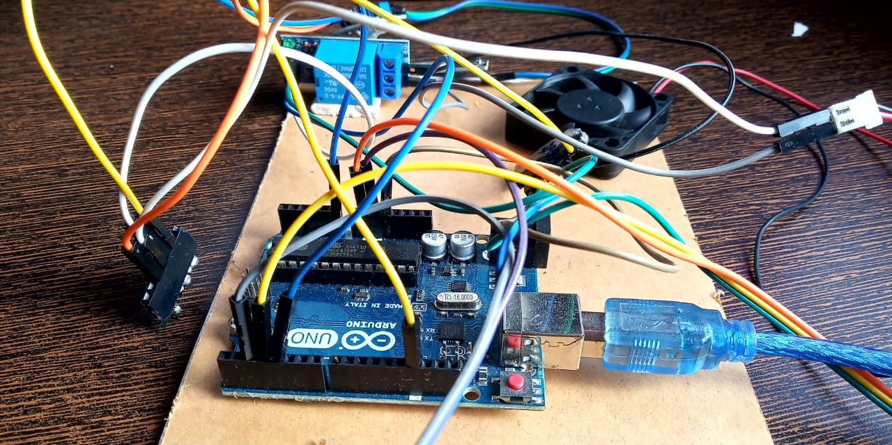
fig :smart baby cradle

Slide 15
Smart baby cradle Website
Modules are :
Registration & login
Uploading/Posting
Adding
Managing, Updations
Viewing
Approval & rejection
Requesting

Slide 16
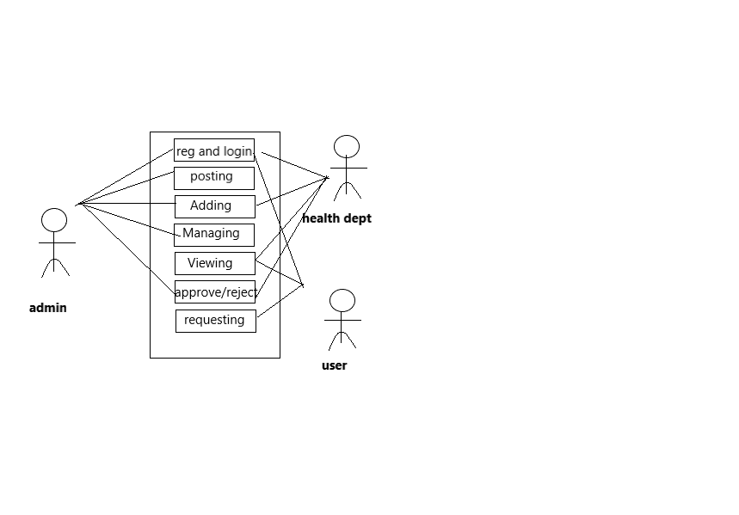
USE CASE

Slide 17
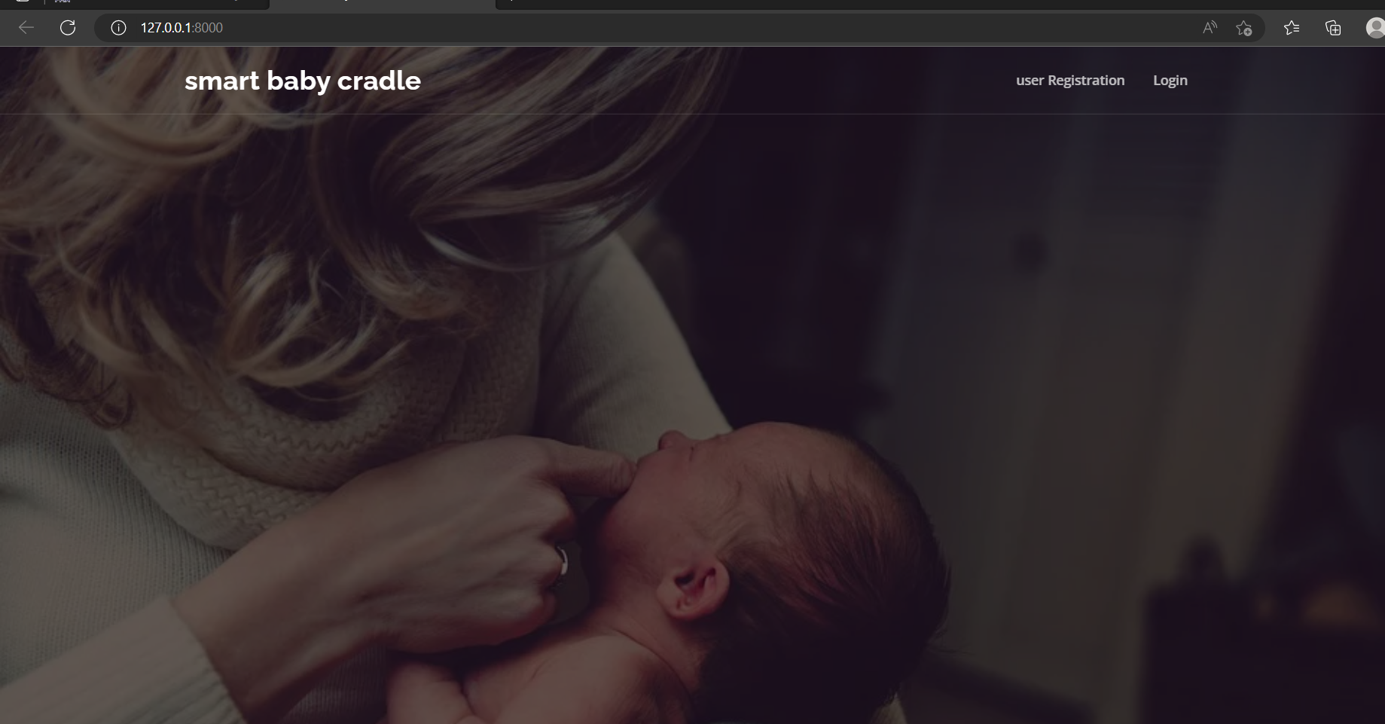
SMART BABY CRADLE

Slide 18
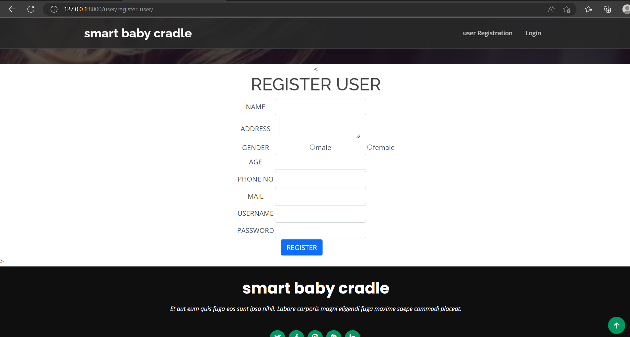
USER REGISTRATION

Slide 19
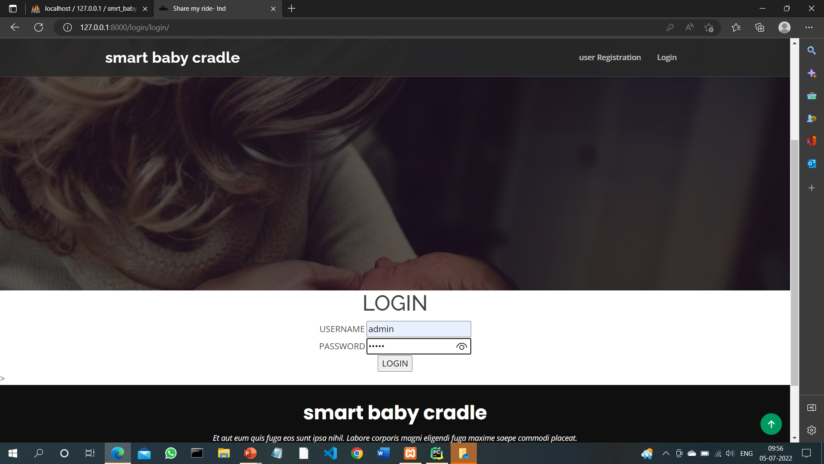
LOGIN

Slide 20
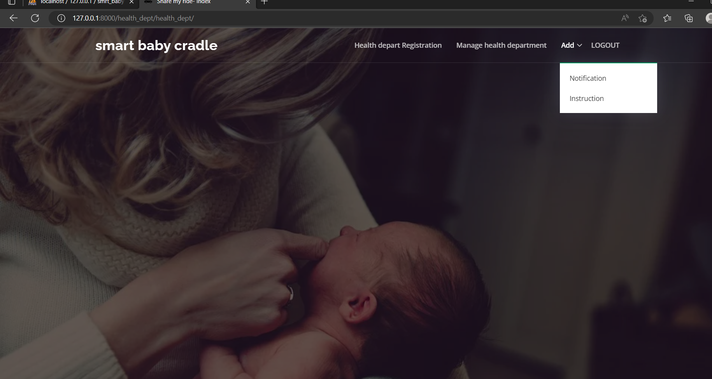
ADMIN

Slide 21
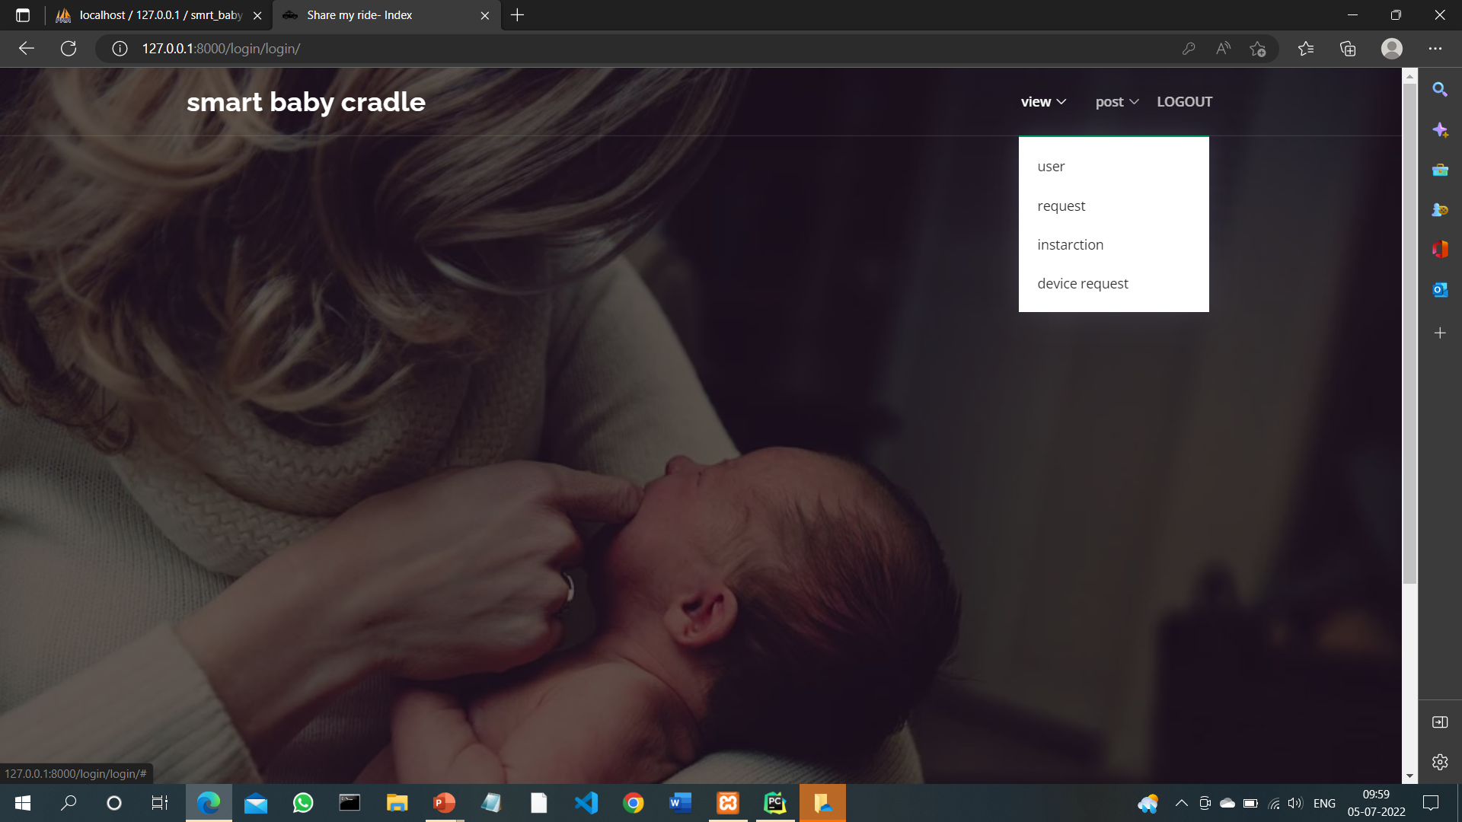
HEALTH DEPARTMENT

Slide 22
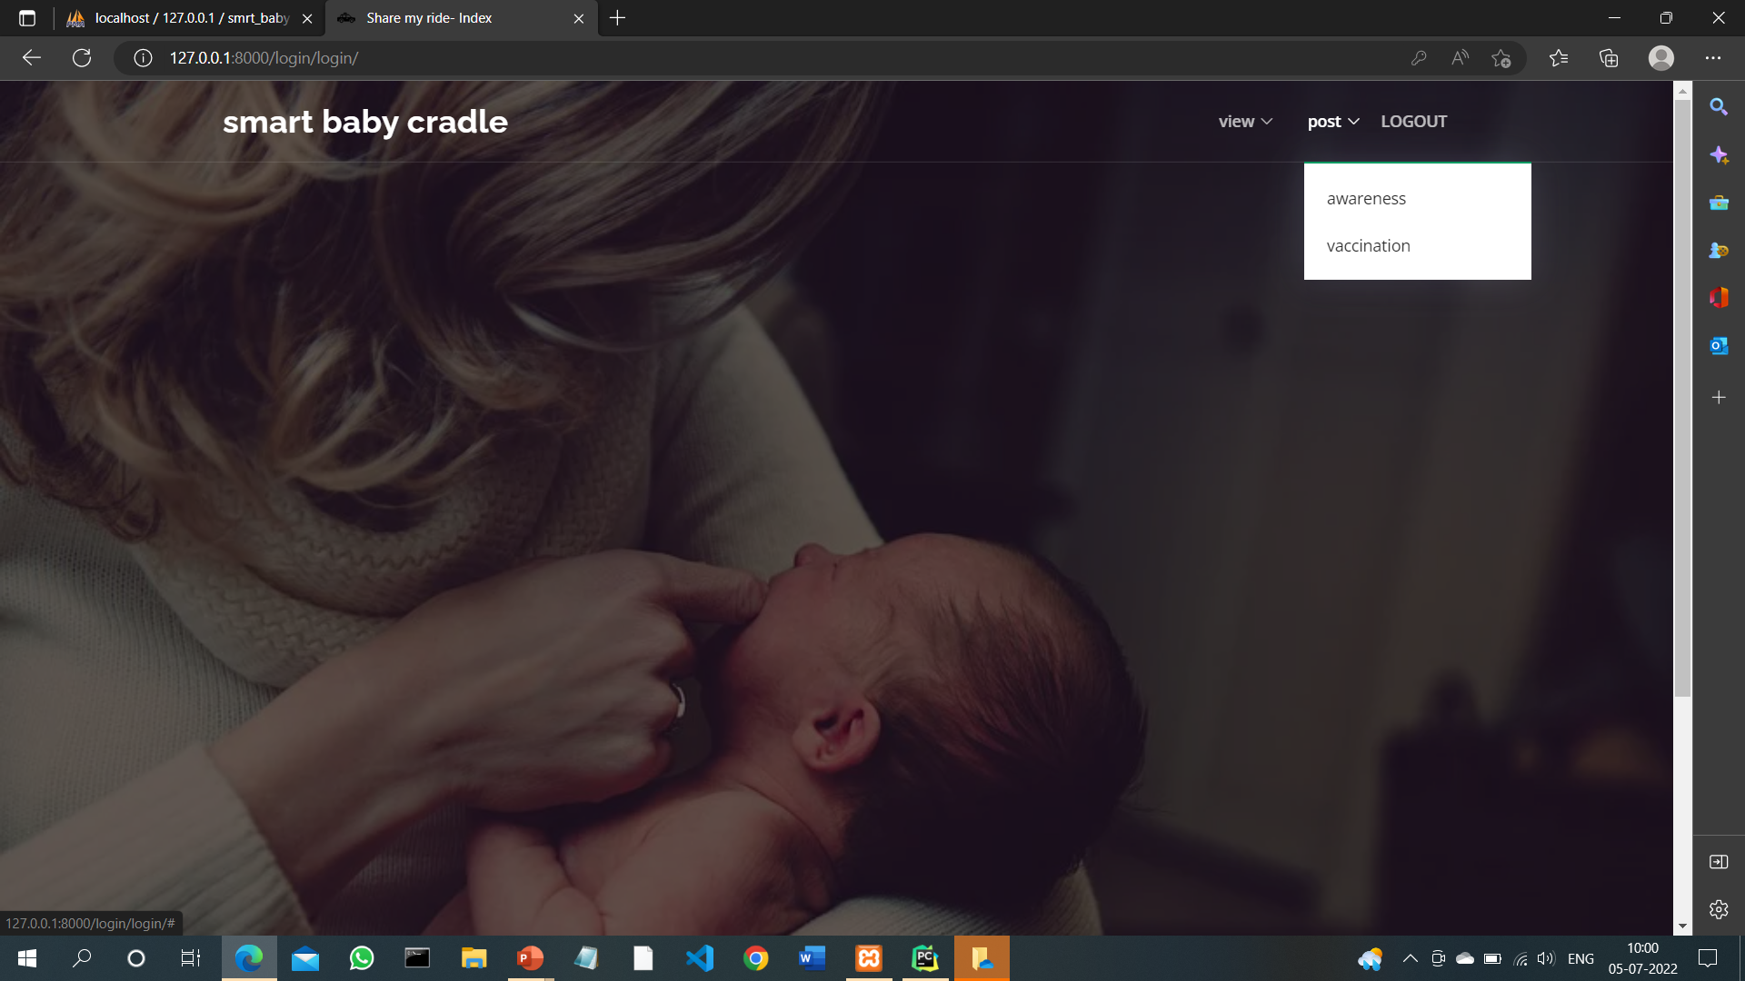
HEALTH DEPARTMENT

Slide 23
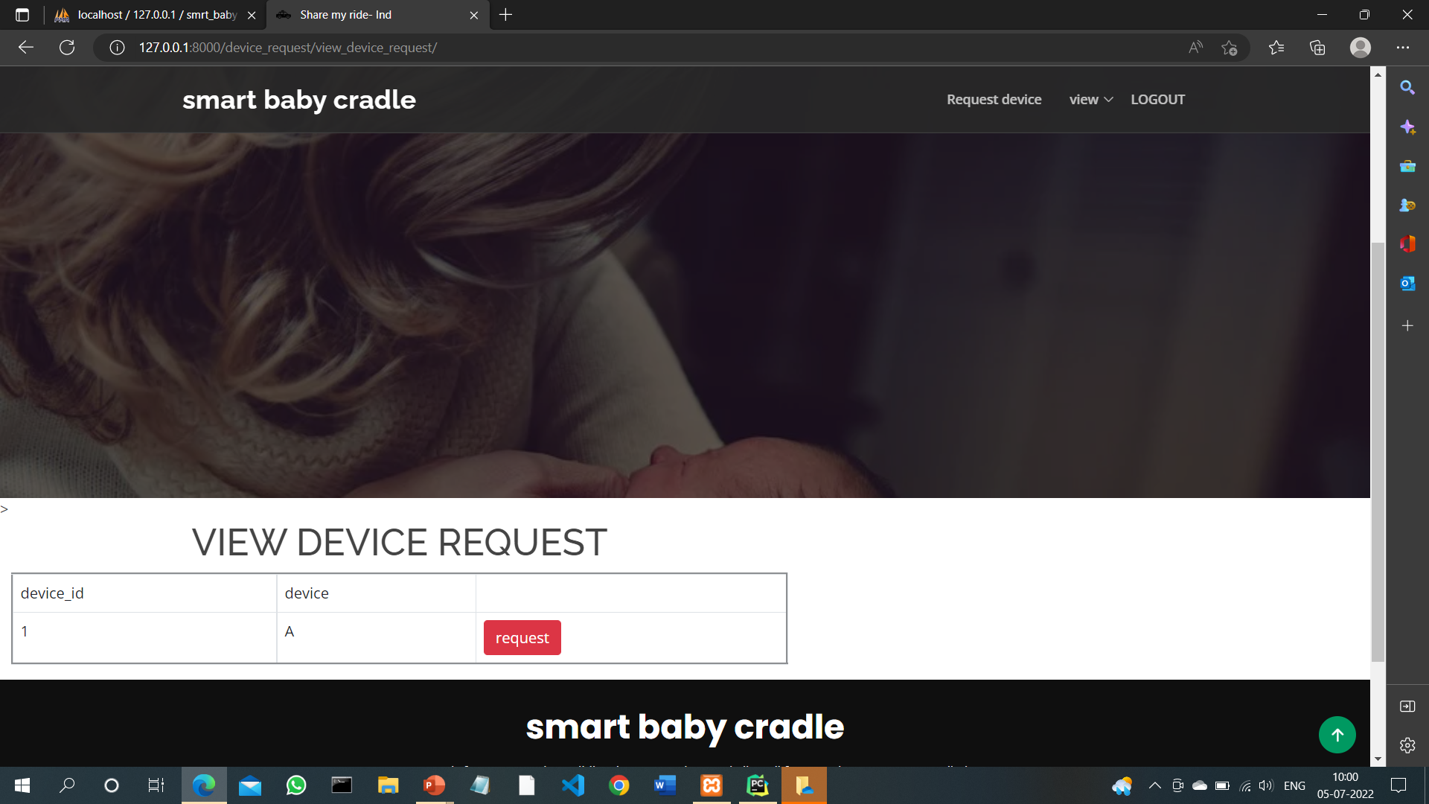
USER

Slide 24
FUTURE DELIVERABLES
Two way communication between cradle and parents.
Can be used in day care centres for the aid of the human beings.

Slide 25
THANK YOU ..)

